Slide 1
Overview of the American Rescue Plan Act of 2021
Presented by: Troy Johnston and Parker Berry
July 15, 2021

Slide 2
OVERVIEW OF FUNDING

Slide 3
LOCAL FISCAL RECOVERY FUND – Amounts & Distribution
Total Amount - $130.2 Billion
  Counties - $65.1 Billion
  Cities - $65.1 Billion
Direct Payment to some Cities
Indirect Payment through State for most Cities
2 Tranches
  ½ sent within 60 days of enactment of Act
  ½ sent not earlier than one year after 1st tranche

Slide 4
GENERAL INFO

Slide 5
LOCAL FISCAL RECOVERY FUND – General Information
Eligibility & Expenditure Deadlines
  March 3, 2021 is when eligibility commences
  December 31, 2024 is deadline to obligate expenditure
  December 31, 2026 to spend the money
Funds may not be used for general infrastructure unless the use complies with ARPA
May not use funds for Federal Match unless specifically authorized
Can use funds to pay cost of administration of ARPA, e.g., consultants and attorneys
Transfers generally allowed for projects within City
  Counties, School districts, Districts, Private entities
Can deposit funds in interest bearing accounts and use interest for general government purposes

Slide 6
ELIGIBLE USES

Slide 7
LOCAL FISCAL RECOVERY FUND – Eligible Uses
  Four Categories:
      To respond to the pandemic or its negative economic impacts, including:
        Assistance to households, small businesses, and nonprofits
        Aid to impacted industries such as tourism, travel, and hospitality
      For premium pay to eligible workers performing essential work during the pandemic, not exceeding $13/hr. up to $25,000/yr.
      For the provision of government services to the extent there has been a reduction of revenue due to the pandemic
      To make necessary investments in water, sewer, or broadband infrastructure

Slide 8
I. PUBLIC HEALTH AND NEGATIVE ECONOMIC IMPACTS

Slide 9
ELIGIBLE USES – I. Public Health and Economic Impacts
      Assistance to households, small businesses, and nonprofits
      Aid to impacted industries such as tourism, travel, and hospitality
      Payments under this use should be designed to address economic harm resulting from or exacerbated by pandemic
        Examples of Public Health eligible uses:
          Covid-19 Mitigation and Prevention: vaccination programs; medical care; testing; contract tracing; support of isolation or quarantine; enforcement of public health orders; public communication efforts; enhancement to healthcare capacity; PPE; support for prevention, mitigation or other services for congregate living facilities (nursing homes/prisons) and schools; ventilation improvements in congregate settings, health care settings and other key locations; capital investments in public facilities to meet pandemic operation needs like physical plant improvements or mitigation tactics in public buildings; expenses to improve design and execution of public health programs (outreach services, data and tech infrastructure improvements, evals, data analysis)

Slide 10
ELIGIBLE USES – I. Public Health and Economic Impacts
  Examples of Public Health eligible uses continued:
    Behavioral Health Care: mental health treatment; substance misuse treatment; other behavioral health services; hotlines; crisis intervention; overdose intervention; outreach services regarding same and preventative medicine
    Public Health and Safety Staff: payroll and benefits of public safety and public health employees to the extent their services are devoted to mitigating or responding to pandemic.
      **presumption exists but different from CRF eligibility in that employee, or his/her operating unit or division, “is primarily dedicated” to responding to pandemic**
      Must have records to support presumption that employee works regularly on pandemic response, but need not routinely track hours

Slide 11
ELIGIBLE USES – I. Public Health and Economic Impacts
    Examples of Responding to Negative Economic Impact Uses:
      Assistance to Unemployed Workers: job training for unemployed due to pandemic or unable to find job due to negative economic impacts of pandemic.
      Assistance to Households:
        Must show negative economic impact from pandemic
        Food assistance; rent; mortgage; utilities; counseling and legal aid to prevent eviction or homelessness; cash assistance (must be reasonable ☺); burials, repairs; weatherization; internet access
      Small Business and Non-profits:
        Must show negative economic impact from pandemic
        Assist with covering payroll, mortgages, rent or other operating costs, utilities, retain employees
        COVID-19 mitigation tactics such as barriers, enhanced cleaning, vaccination and testing programs
      Aid to Impacted Industries:
        Must show negative economic impact from pandemic
        COVID-19 mitigation measures and social distancing techniques and PPE
        Aid for planned expansion or upgrade of tourism, travel and hospitality facilities delayed due to pandemic
        Records required

Slide 12
ELIGIBLE USES – I. Public Health and Economic Impacts
  Examples of Responding to Negative Economic Impact Uses, continued:
    Those communities disproportionally impacted by the pandemic and/or living in QCTs:
      Housing and Neighborhoods for Low-Income:
        Services to address homelessness and access to stable housing
        Affordable housing development to increase supply
        Housing vouchers
      Addressing Educational Disparities:
        Assistance to high-poverty school districts
        Enrichment and afterschool programs
        Social, emotion and mental health needs of students
      Promoting Healthy Childhood Environment
        Childcare; enhanced services for child welfare and foster youth

Slide 13

ELIGIBLE USES – I. Public Health and Economic Impacts
  This category of uses does NOT include:
    Contribution to rainy day funds, financial reserves or similar funds.
    General infrastructure projects UNLESS the project responded to a specific pandemic public health need (e.g., investments in facilities for delivery of vaccines) or a specific negative economic impact like affordable housing in a QCT
    Payment of debt service incurred prior to March 3, 2021

Slide 14
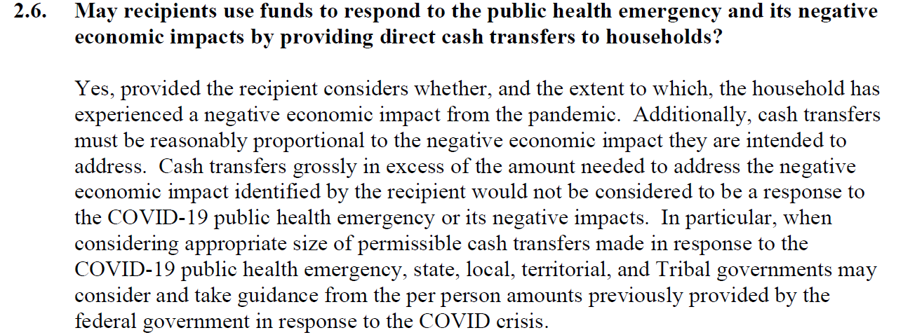
I. Public Health and Economic Impacts – Pertinent FAQs

Slide 15
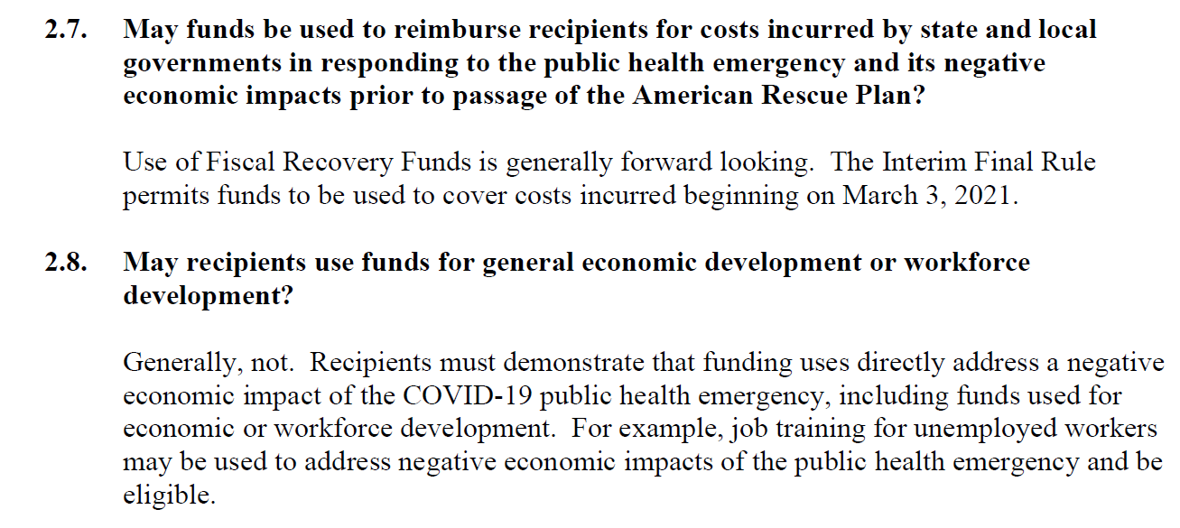
I. Public Health and Economic Impacts – Pertinent FAQs

Slide 16
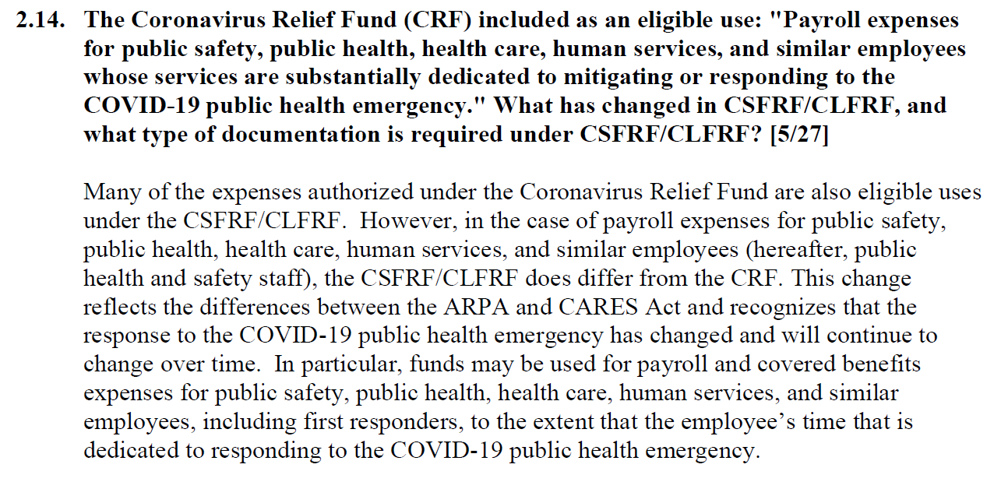
I. Public Health and Economic Impacts – Pertinent FAQs

Slide 17
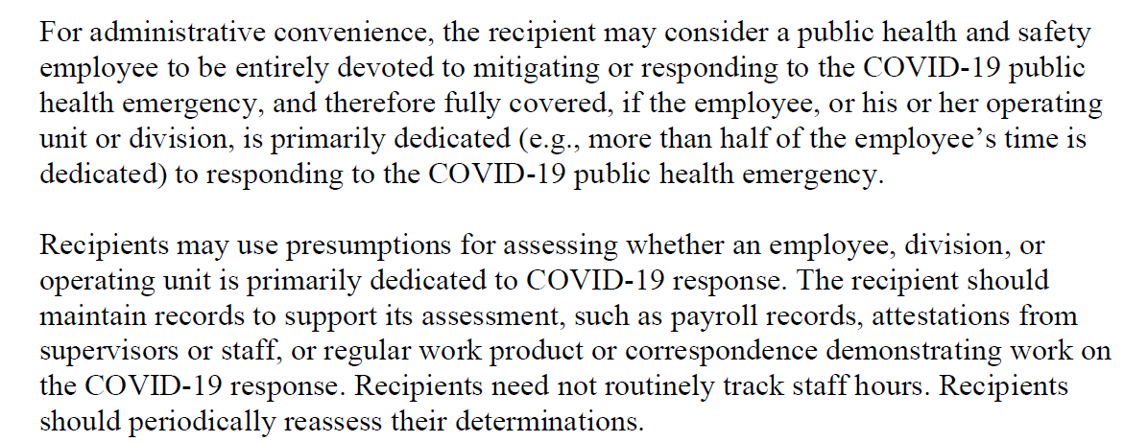
I. Public Health and Economic Impacts – Pertinent FAQs

Slide 18
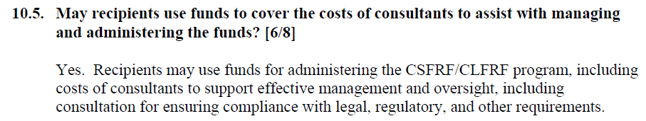
I. Public Health and Economic Impacts – Pertinent FAQs

Slide 19
II. PREMIUM PAY

Slide 20
ELIGIBLE USES – II. Premium Pay
Premium pay to essential workers during pandemic or to provide grants to other employers who employ eligible essential workers
Essential workers are those maintain continuity of operations of essential critical infrastructure sectors, including those protecting the health and wellbeing of their communities
  Staff at nursing homes and hospitals
  Workers at farms, grocery stores, restaurants
  Truckers
  Sanitation workers and janitors
  Public health and safety
  Childcare workers and educators
  Social service and human services staff
  Others can be designated by government
Essential work means work involving regular in-person interactions or regular physical handling of items handled by others
  Telework from residence not eligible
Capped at $13/hour and not to exceed $25,000 per worker in addition to normal wage and targeted for low income worker
May be provided retroactively for work performed since start of COVID-19 where not previously additionally compensated

Slide 21
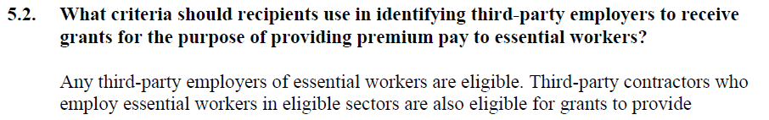
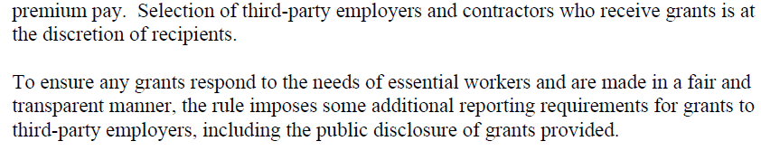
II. Premium Pay – Pertinent FAQ

Slide 22
III. REVENUE LOSS

Slide 23
ELIGIBLE USES – III. Revenue Loss
Recipients may use payments from the Fiscal Recovery Funds for the provision of government services to the extent of the reduction in revenue experienced due to the COVID-19 public health emergency. . . . [A] recipient's reduction in revenue is measured relative to the revenue collected in the most recent full fiscal year prior to the emergency.

Slide 24
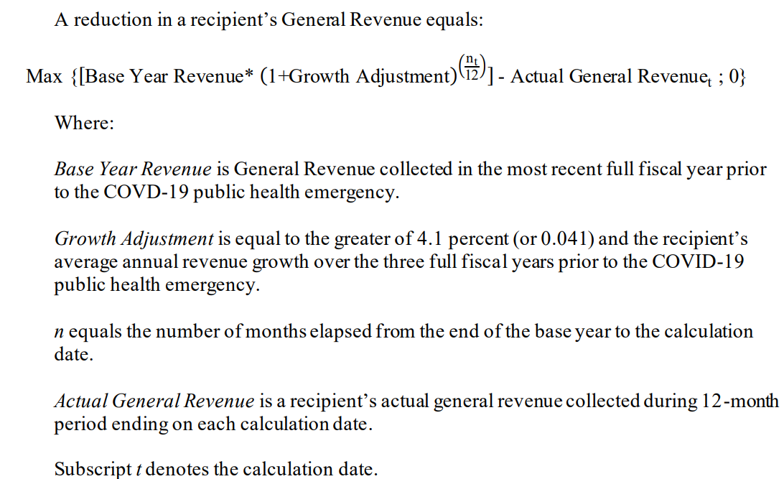
ELIGIBLE USES – III. Revenue Loss

Slide 25
ELIGIBLE USES – III. Revenue Loss
“REVENUE”
INCLUDED
Taxes
“Current charges”
  Public education charges
  Public hospital charges
  Toll revenue
Misc. general revenue
  Rents
  Royalties
  Royalties
  Fines
Transfers from State & Local governments
Facilities operated by government included in general revenue– pools, marinas, museums, zoos, etc. [FAQ 3.3]
EXCLUDED
Utilities
Insurance trusts
Transfers from Federal government (even via State)
Refunds and other correcting transactions
Debt proceeds
Sale of investments
Private trust transactions

Slide 26
ELIGIBLE USES – III. Revenue Loss
USE OF FUNDS
Is it “Government services”?
INCLUDES (but isn’t limited to)
To “the extent of reduction in revenue”
Maintenance of infrastructure
Pay-go spending for building new infrastructure, including roads
Modernization of cybersecurity
  Hardware
  Software
  Protection of critical infrastructure
Health service
Environmental remediation
School or educational services
Police, fire, and other public safety services
EXCLUDES
    Interest & principal on outstanding debt
            Costs of issuance for incurring debts
Replenishing rainy day funds or other reserve funds
Paying settlements or judgements
Pension deposits
Using funds for non-federal match if barred by regulation or statute
No pre-approval from Dept. of Treasury required to funds

Slide 27
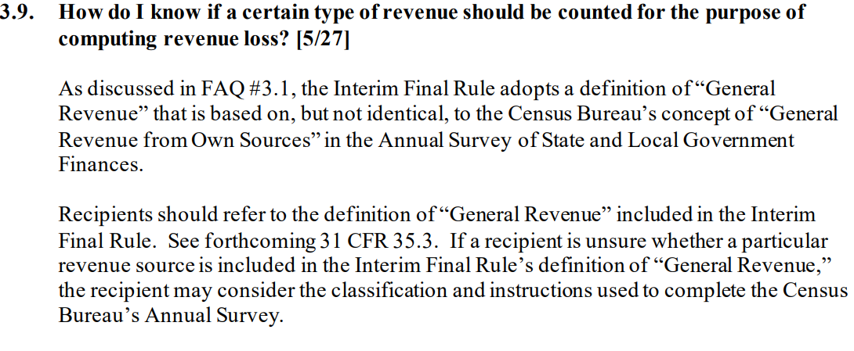
III. Revenue Loss – Pertinent FAQs

Slide 28
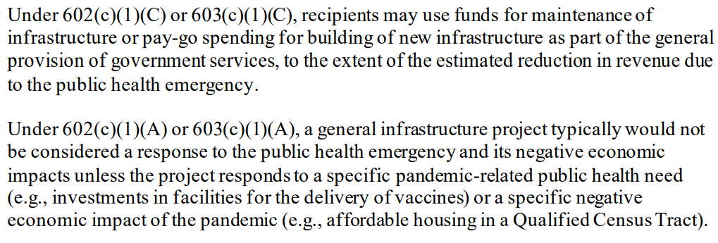
III. Revenue Loss – Pertinent FAQs

Slide 29
IV. WATER, SEWER OR BROADBAND INFRASTRUCTURE

Slide 30
ELIGIBLE USES – IV. Water, Sewer or Broadband Infrastructure
To assist in meeting the critical need for investments and improvements to existing infrastructure in water, sewer, and broadband, the Fiscal Recovery Funds provide funds to State, local, and Tribal governments to make necessary investments in these sectors. The interim final rule outlines eligible uses within each category, allowing for a broad range of necessary investments in projects that improve access to clean drinking water, improve wastewater and stormwater infrastructure systems, and provide access to high-quality broadband service.

Slide 31
ELIGIBLE USES – IV. Water, Sewer or Broadband Infrastructure
Purposes of this category
  To protect health and assist in compliance with drinking water regulations
  Response to COVID-19 which diverted funds financial resources from water, sewer and broadband
  Universal need for broadband connectivity in daily life – home, work and education
“Necessary investments” are designed to
  Provide a minimum level of service
  And are unlikely to be made with private funds
  In unserved or underserved areas
Project may serve a wider area, but prioritize unserved or underserved household and businesses
  “Necessary investments include projects that are required to maintain a level of service that, at least, meets applicable health-based standards, taking into account resilience to climate change, or establishes or improves broadband service to unserved or underserved populations to reach an adequate level to permit a household to work or attend school, and that are unlikely to be met with private sources of funds.”

Slide 32
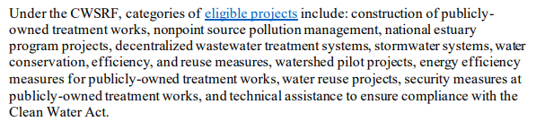

ELIGIBLE USES – IV. Water, Sewer or Broadband Infrastructure
ELIGIBLE WATER & SEWER INFRASTRUCTURE
State Revolving Loan Programs
  Clean Water State Revolving Fund (CWSRF)
  Drinking Water State Revolving Fund (DWSRF)

Slide 33
ELIGIBLE USES – IV. Water, Sewer or Broadband Infrastructure
ELIGIBLE WATER & SEWER INFRASTRUCTURE
Consolidation/establishment of drinking water systems
Improve drinking water infrastructure and storage systems
  Replacing lead pipe
Construct publicly owned wastewater treatment infrastructure
Manage and treat stormwater or subsurface drainage water
Facilitate water reuse
Protect water or sewer infrastructure
List is NOT exhaustive
NOT ELIGIBLE: Dams & Reservoirs

Slide 34
ELIGIBLE USES – IV. Water, Sewer or Broadband Infrastructure
ELIGIBLE WATER & SEWER INFRASTRUCTURE
Projects that address climate change
  Managing/preventing potential sources of pollution
  Reduce energy to treat drinking water/water treatment facilities
  Projects that address mitigating increased stormwater runoff
    Rain gardens that provide water storage and filtration
    Green streets that direct and filter rainwater from impervious services

Slide 35
ELIGIBLE USES – IV. Water, Sewer or Broadband Infrastructure
BROADBAND
What is “broadband”
  100 Mbps upload/download
  Impractical circumstances (geographical, topographical, or financial constraints) allow 100 Mbps download/20Mbps upload
Project considerations
  Must serve “unserved or underserved households or business”
    Holistic approach
    Those that are not currently served by a wireline connection that reliably delivers at least 25 Mbps download speed and 3 Mbps of upload speed
  Avoid duplication
  Focus on last mile connections
  Support providers whose goal is service and not profit (Local governments, non-profits and cooperatives)
  Assistance to households

Slide 36


IV. Water, Sewer or Broadband Infrastructure – Pertinent FAQs

Slide 37
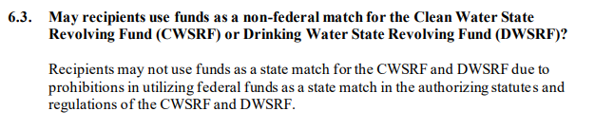
IV. Water, Sewer or Broadband Infrastructure – Pertinent FAQs

Slide 38
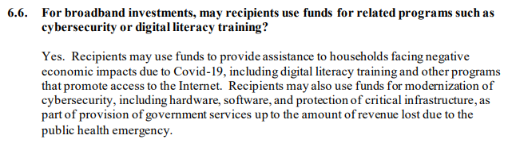
IV. Water, Sewer or Broadband Infrastructure – Pertinent FAQs

Slide 39
REPORTING AND OTHER REQUIREMENTS

Slide 40
LOCAL FISCAL RECOVERY FUND – Reporting and Other Requirements
  Reporting Requirement to Secretary of Treasury
      “Periodic reports”
        Interim report – One time report. Activity from date of award to July 31, 2021 and due by August 31, 2021 (Not Required for NEUs)
        Quarterly Project and Expenditure Reports – Financial data and information on contracts and subawards over $50k, types of projects funded and other info. First report from award through September 30, 2021 and due October 31, 2021. Afterwards, due annually for NEUs.
        Recovery Plan Performance Reports – detailed reports helping local residents understand how money being spent (Not Required for NEUs)
    Uniform Guidance for grants applies (2 CFR Part 200)
    Recoupment and clawbacks

Slide 41
American Rescue Plan Act of 2021 – Questions
Troy Johnston
(601) 985-4419
troy.johnston@butlersnow.com
Parker Berry
(601) 985-4402
parker.berry@butlersnow.com

