Slide 1
ARPA Reporting 101

Slide 2
Treasury Reporting HUB
Ensure that your communities SAM.gov profile is up to date
Ensure that you Know the total allocation of ARPA funds
The next reports are due in the US Treasury Reporting Hub by April 30, 2025
Ensure that you have recorded the uses & obligations of your ARPA funds.

Slide 3
Reporting to the Treasury Department
Reporting to the US Treasury Department
When your ARPA direct deposits totaled less than $10,000,000 – you may claim the
“standard allowance”.

Slide 4
https://www.youtube.com/@USTreasGov
The above web site contains all of the “Youtube” videos posted by the US Treasury.
If you’re community received less than $10,000,000 – You may reference the
“WEBINAR: State & Local Fiscal Recovery Funds: Project & Expenditure Simplified Reporting” video.
This video has very good step by step instructions for the simplified reporting.
To begin reporting, use the Treasury portal to log in and ensure that your “Recipient Profile” from the menu on the left is accurate.

Slide 5
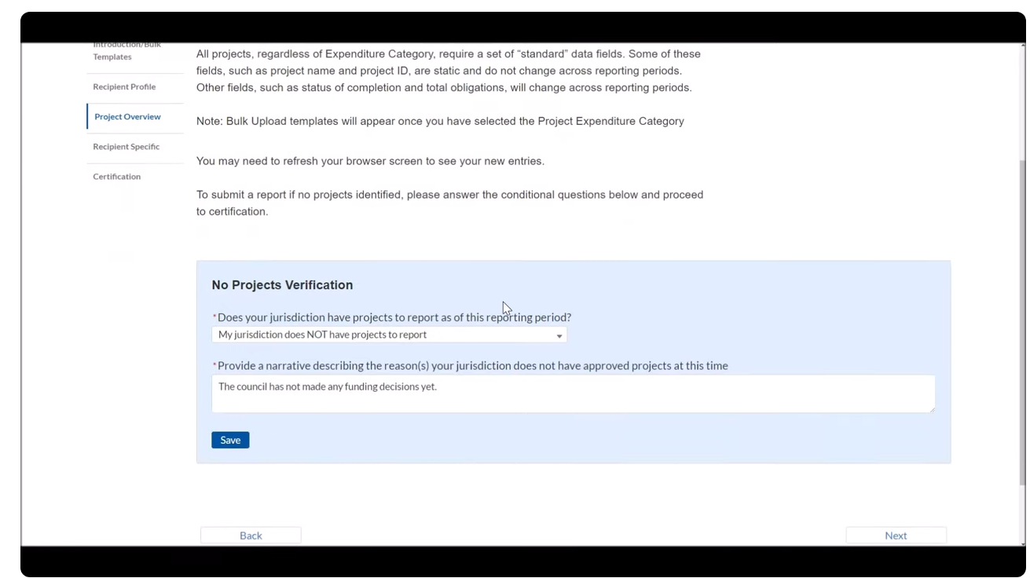
If you have not “obligated” the money to a project, you should select
“My jurisdiction does not have projects to report” and update
the narrative portion

Slide 6
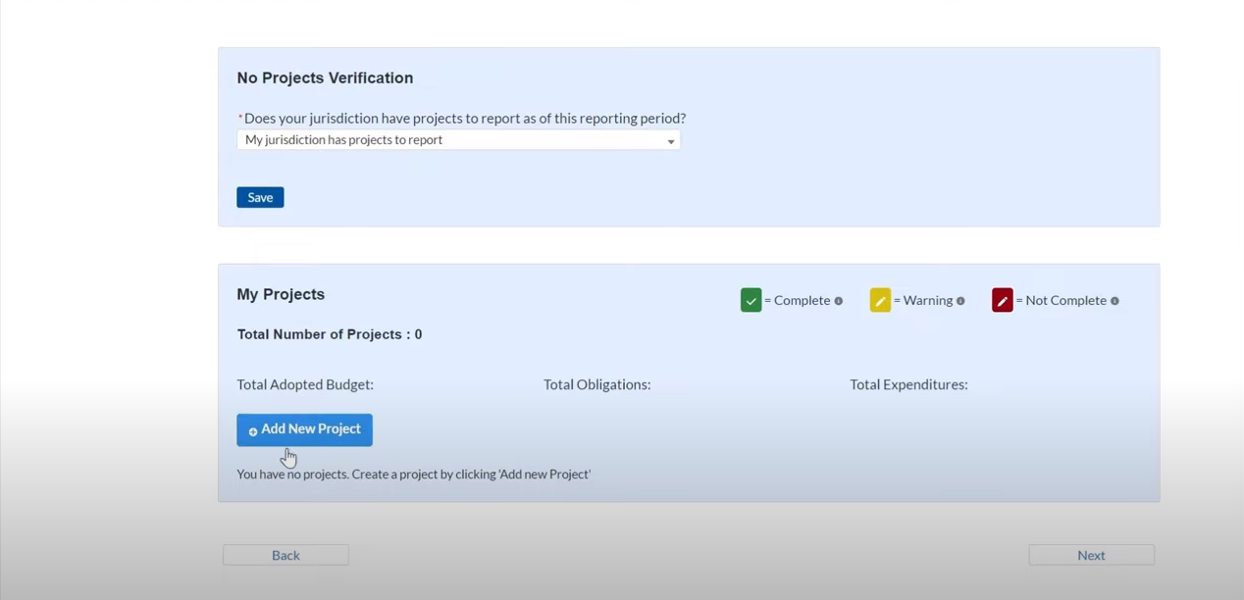
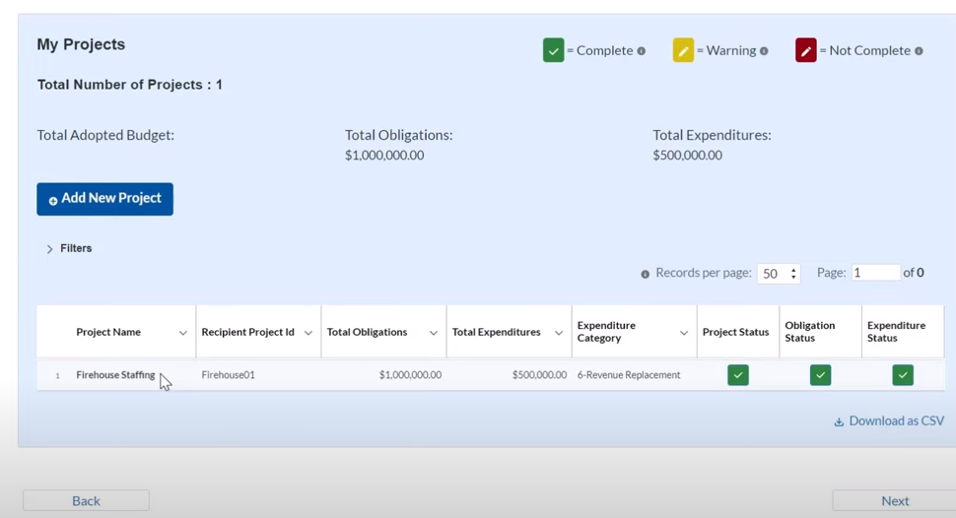
TO REPORT ON FUNDS THAT YOU HAVE OBLIGATED, SELECT
“MY JURISDICTION DOES HAVE PROJECTS TO REPORT.”
If you’ve not created a project, you’ll need to “Add New Project”
If you’ve reported on this project in the past, or previously created the project, select all sections you wish to update.

Slide 7
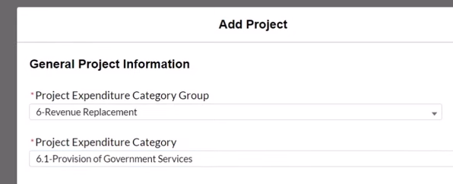
When adding a new project
Most communities will select
“Revenue Replacement” & “Provision of Government Services” in the categories.

Slide 8
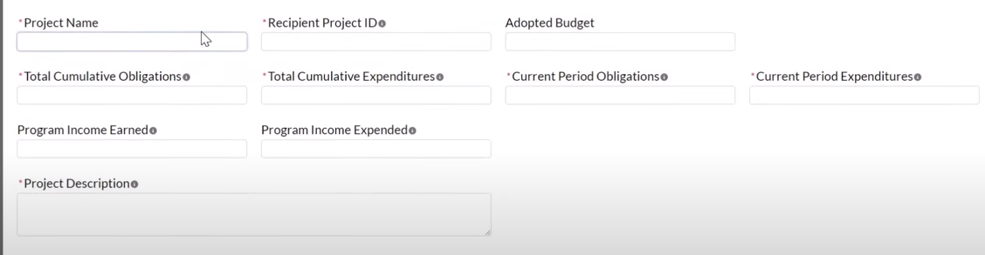
Complete the Grid with information for your project. The “Adopted Budget” will be
100% of your ARPA funds if you’re using it all as match for an MCWI project.
Your “Cumulative Obligations” are “How much of your ARPA funds are you dedicating
to the project?”
Your “Cumulative Expenditures” are “How much of your ARPA funds have you actually spent
on the project?”
“Current Period” sections are referencing dollar amounts since the last report.
“Program Income Earned” and “Program Income Expended” will be concerning any interest
earned from the money in the bank.

Slide 9
Continue back to this page, select the sections to update the report and click “next”

Slide 10
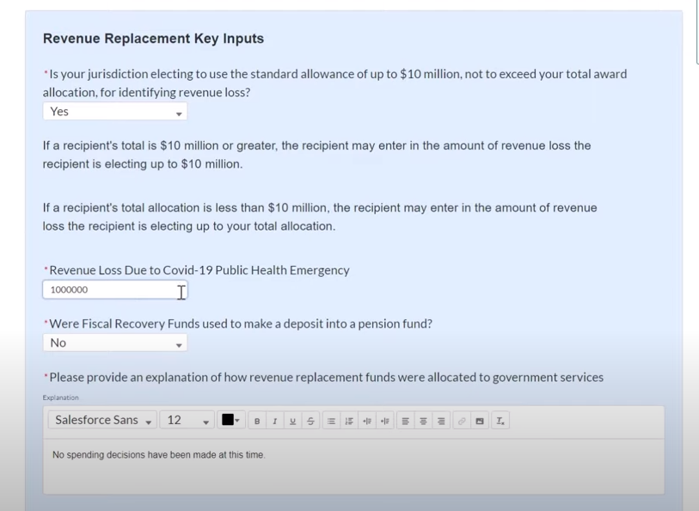
Complete the “Revenue Replacement Key Inputs” & save/certify,
and your report is complete.

